Slide 1
HELP

Slide 2
What is the purpose of “Help”?
Gives organizations a resource for finding volunteers
Encourages others to volunteer within their communities
Rewards people who consistently volunteer
Notes:
The app is a way for people to give back within their communties by giving people the necessary resources

Slide 3
Interaction with Middle school students
They were really enthused about the app
Most them were interested in becoming engineers
They had a lot of good ideas
Colorful backgrounds
A way to reward consistent volunteers
A way to find different volunteer events
Notes:
At first they were confused about the purpose of the app because of the name “Help”.They were really specific about the volunteer categories we should add in our search filters, kept us waAge restrictions for volunteers

Slide 4
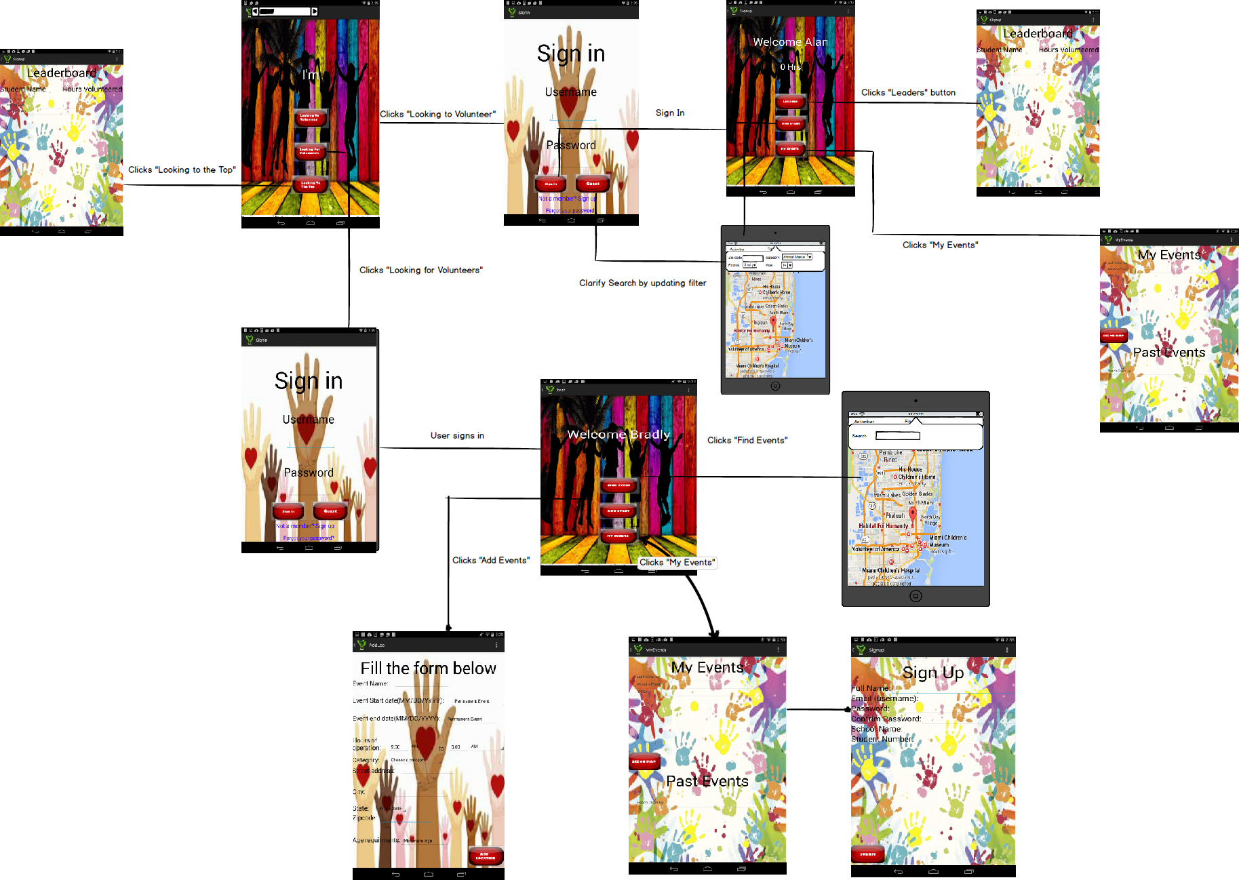
Storyboard

Slide 5
Responsibilities
Kenith - Layout
Ahmed -Java code
Oscar -Processing code

Slide 6
Functionality of help
Parse.com
Google APIs
Events that expire are removed from map
Leader Board
“Forgot my password” link
Notes:
Users are differentiated in our app by the string value in the column account type ; “V” is for volunteers and “VC” is for volunteer coordinator. Used given methods in java to retrieve the latitude and longitude values from addresses entered by users so the markers can be viewed on the map, .Leader board is an activity that shows the top volunteers and the hours they’ve contributed so far. This is a way to show everyone volunteering that they are appreciated . If you are a volunteer or a volunteer coordinator and you forget your password you will get a email asking you to reset your password.

Slide 7
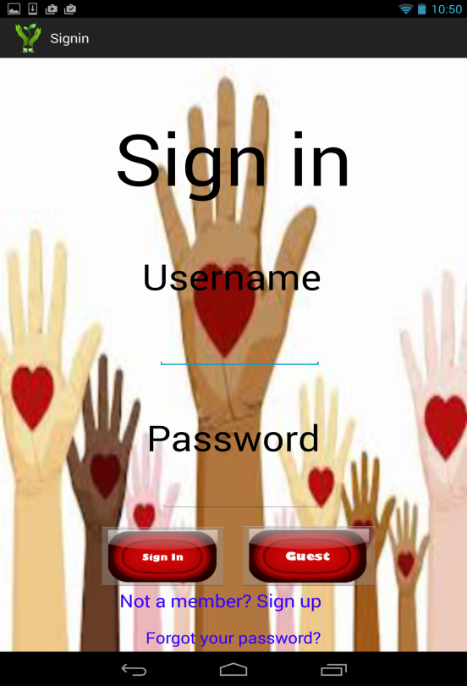
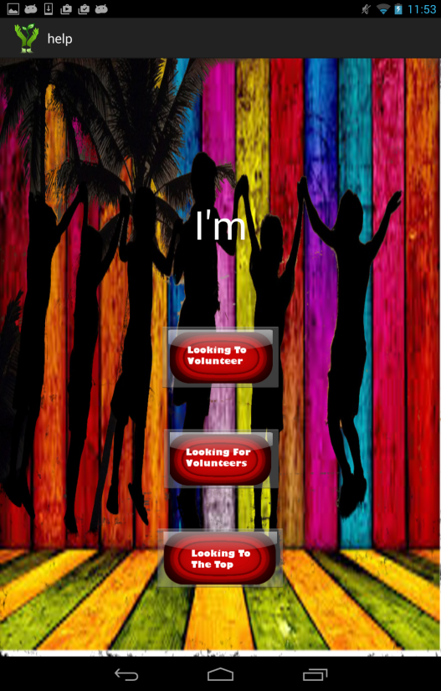
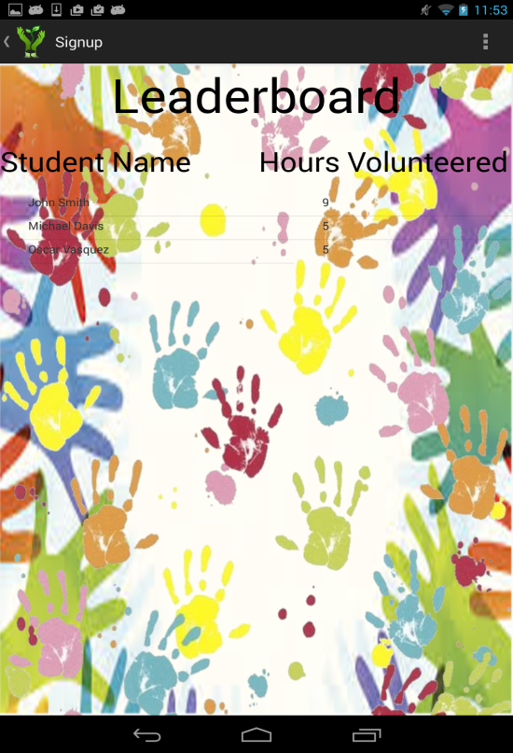
Layout of Help
Buttons and background was created using Gimp
3 different backgrounds in the app
Notes:
The layout to the left is for sign in pages , the layout in the middle is the layout for the user home activities and the main activity when the app is first launched, and the layout to the right is for leader board , my events and signup activities. With the backgrounds I did a lot of manipulating certain images by erasing image backgrounds and adding another image as the back layer. In Gimp 2 I used the tools option to make the top portion of the button glossy

Slide 8
What will kids be able to change in our App
All resources and strings will be modifiable through processing
Examples of use:
Students will be able to modify the app to be a resource for finding people who want to play in a pick up basketball game
Notes:
So instead of the app being focused around volunteering it can be used for a different agenda . The categories within the search filter will be altered by the students
https://github.com/

